Slide 1

RUNGTA COLLEGE OF DENTAL SCIENCES AND RESEARCH
DYSPHAGIA
DEPARTMENT OF GENERAL MEDICINE

Slide 2
SPECIFIC LEARNING OBJECTIVES
MUST KNOW
NICE TO KNOW
DESIRE TO KNOW
WHAT IS DYSPHAGIA
CLASSIFICATION
ETIOLOGY
INVESTIGATION
DIAGNOSIS
TREATMENT
INTRODUCTION
HISTORY

Slide 3
CONTENTS
INTRODUCTION
CLASSIFICATION
ETIOLOGY
HISTORY
INVESTIGTIONS
DIAGNOSIS
TREATMENT
SUMMARY

Slide 4
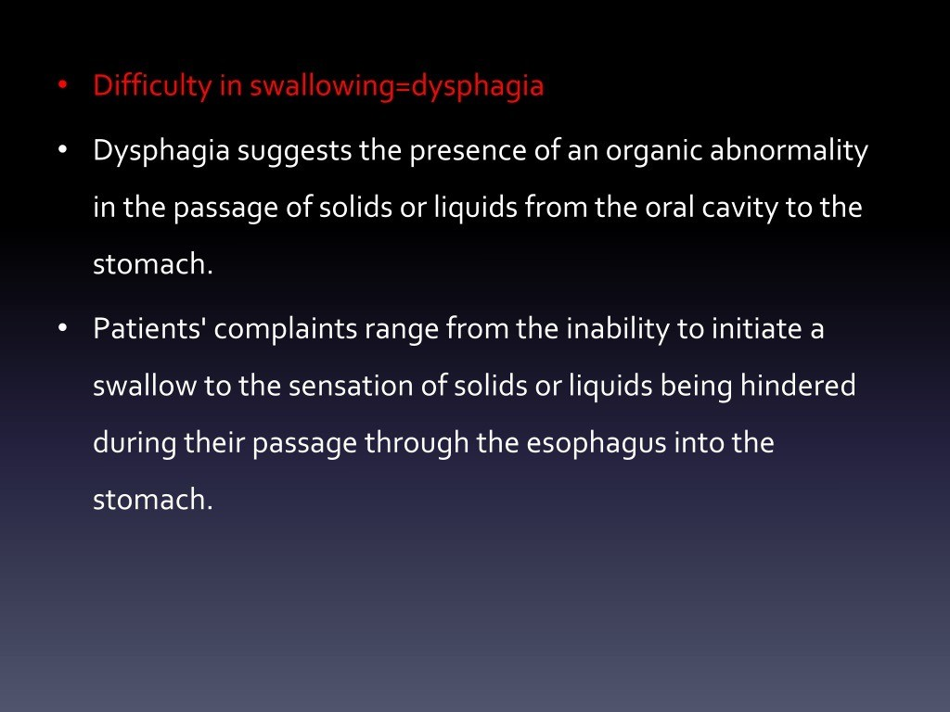

Slide 5
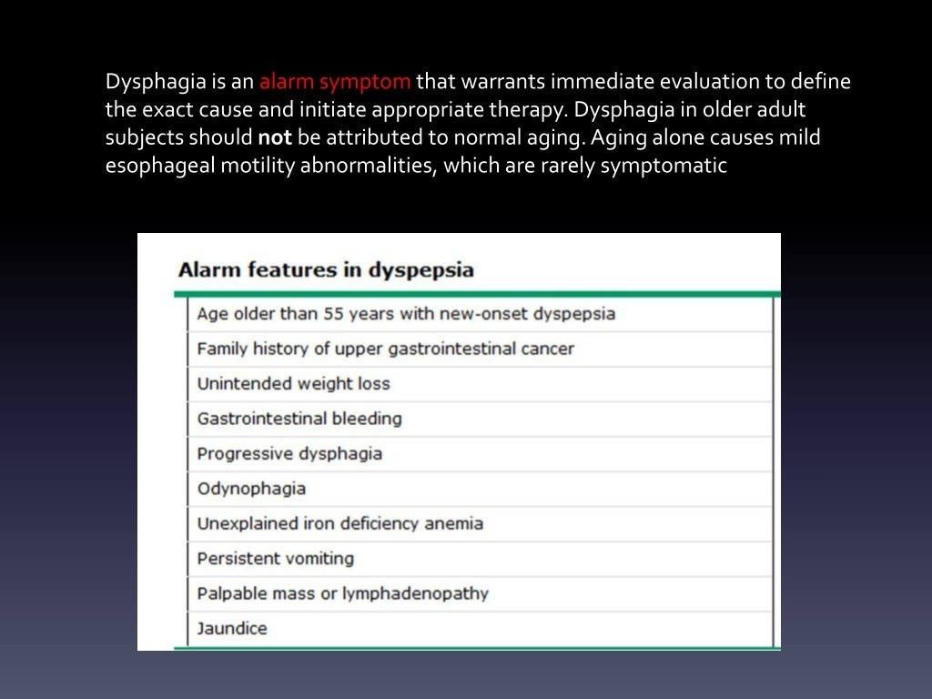

Slide 6
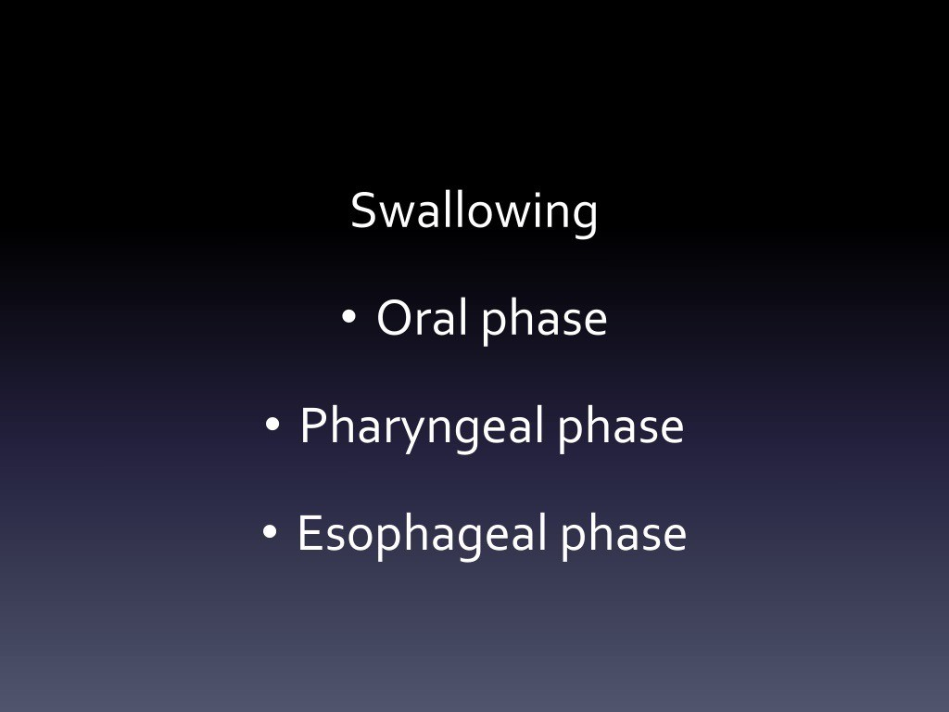

Slide 7
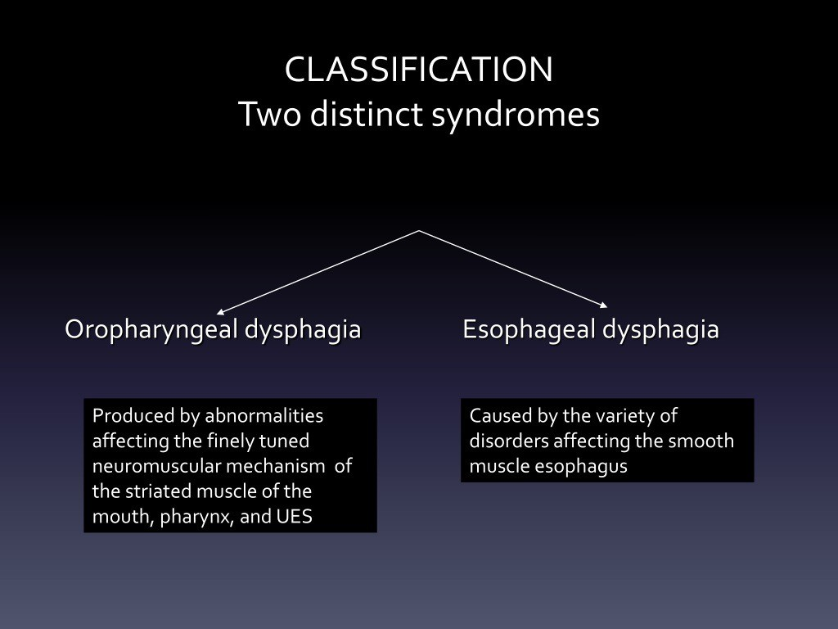

Slide 8
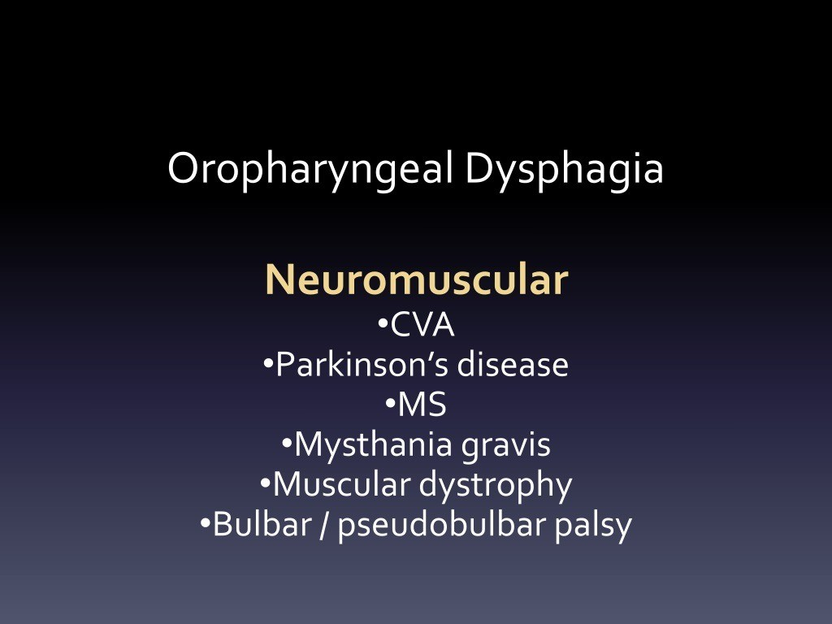

Slide 10
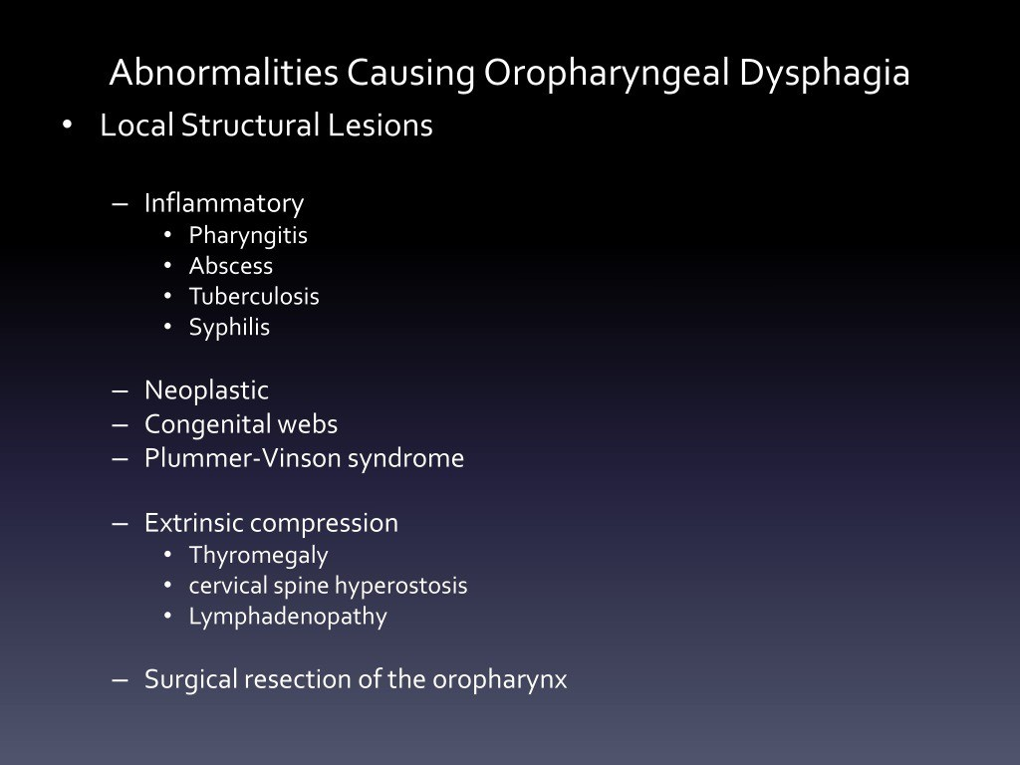

Slide 11
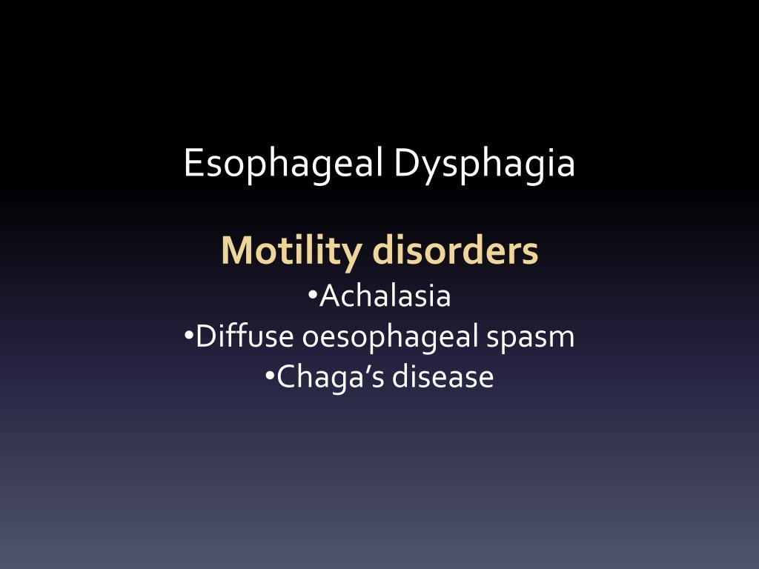

Slide 12
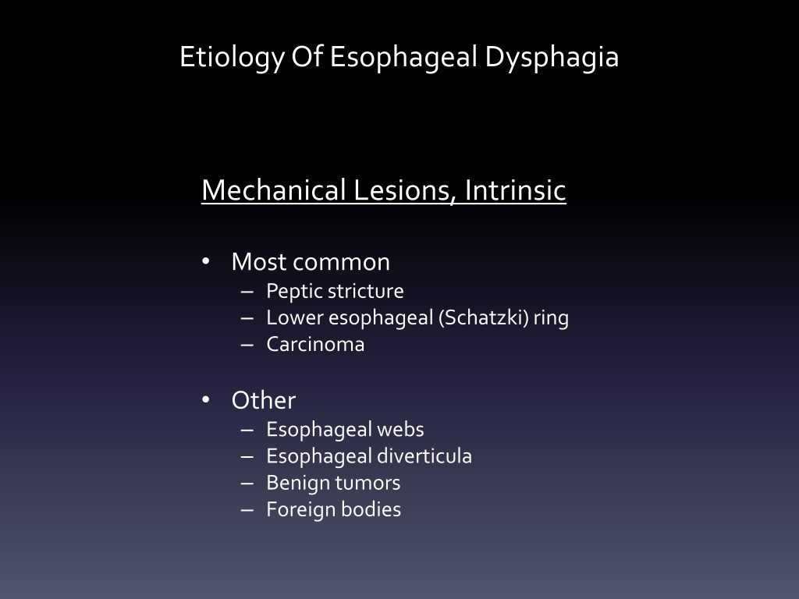

Slide 14
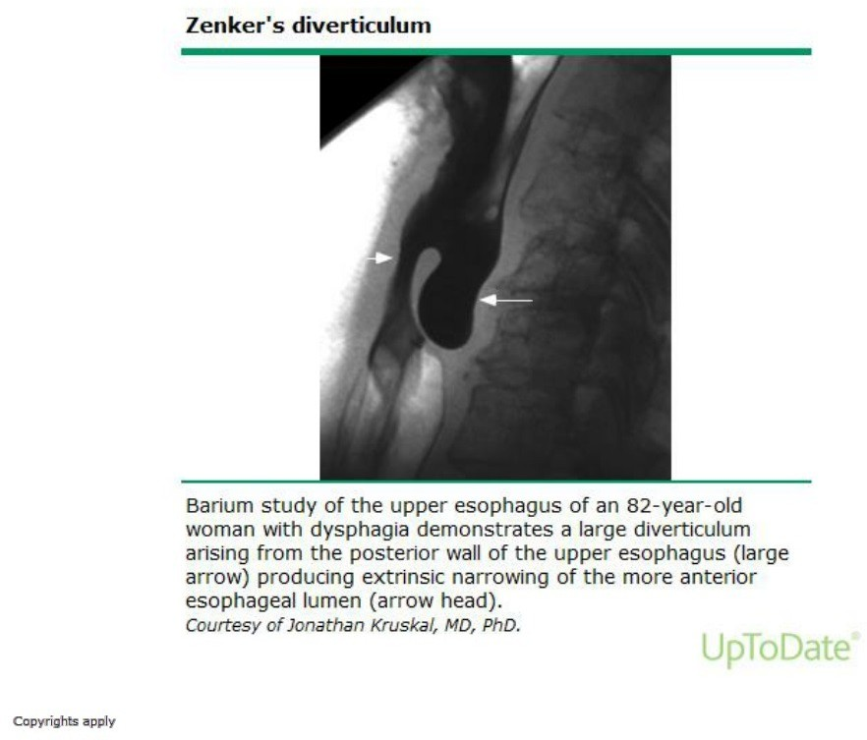

Slide 15
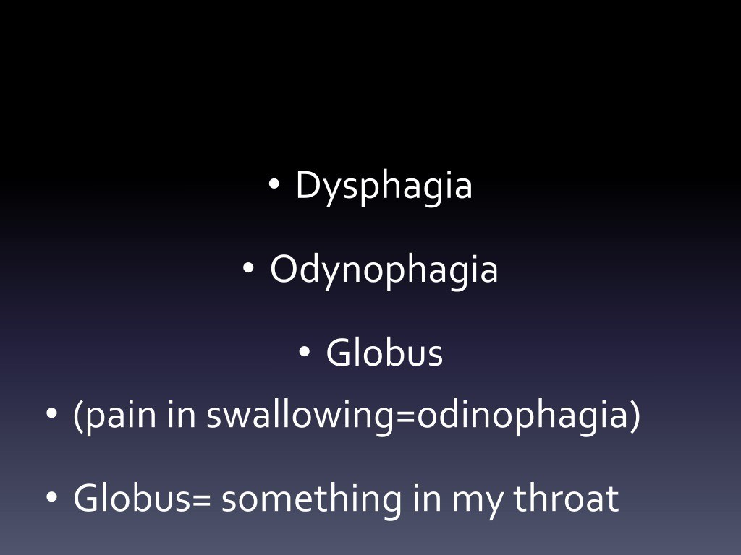

Slide 16
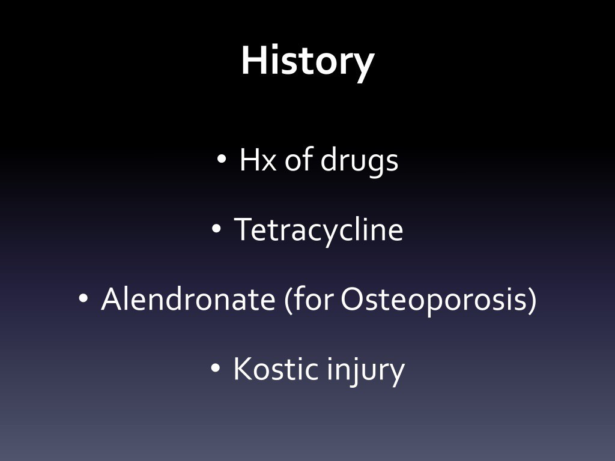

Slide 18
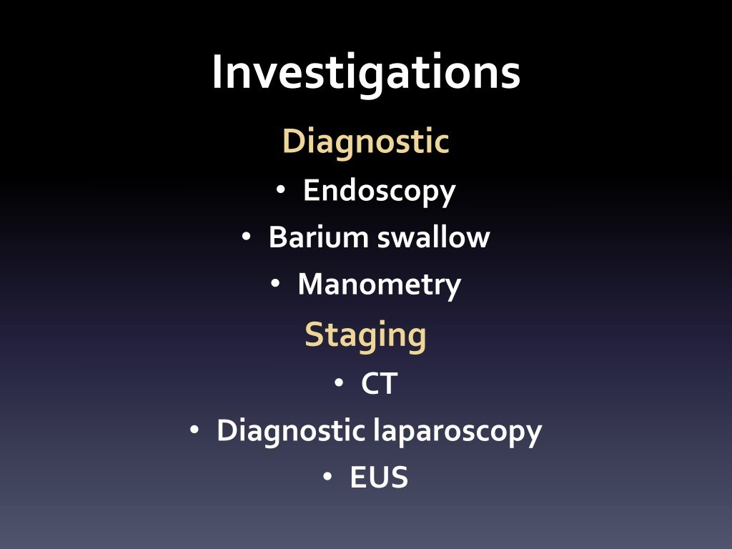

Slide 19
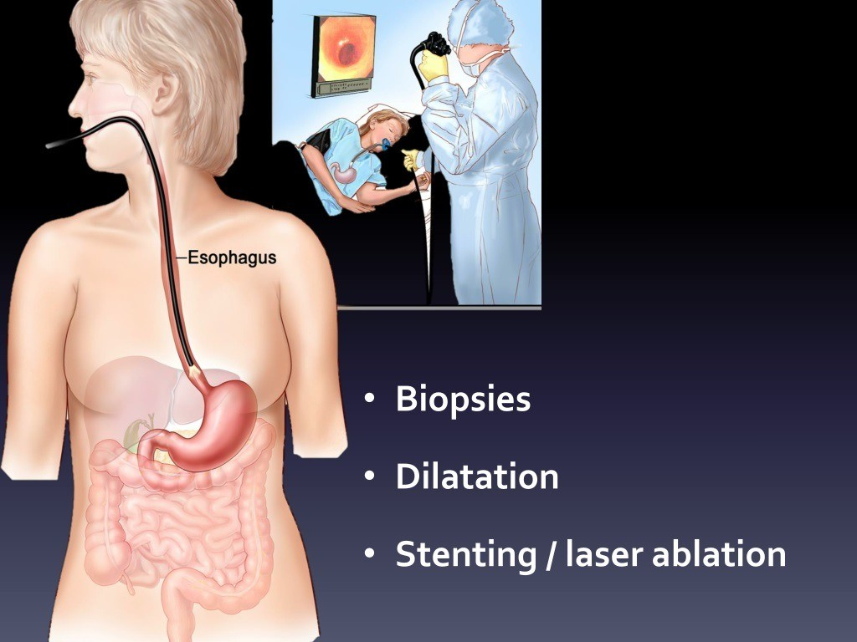

Slide 20
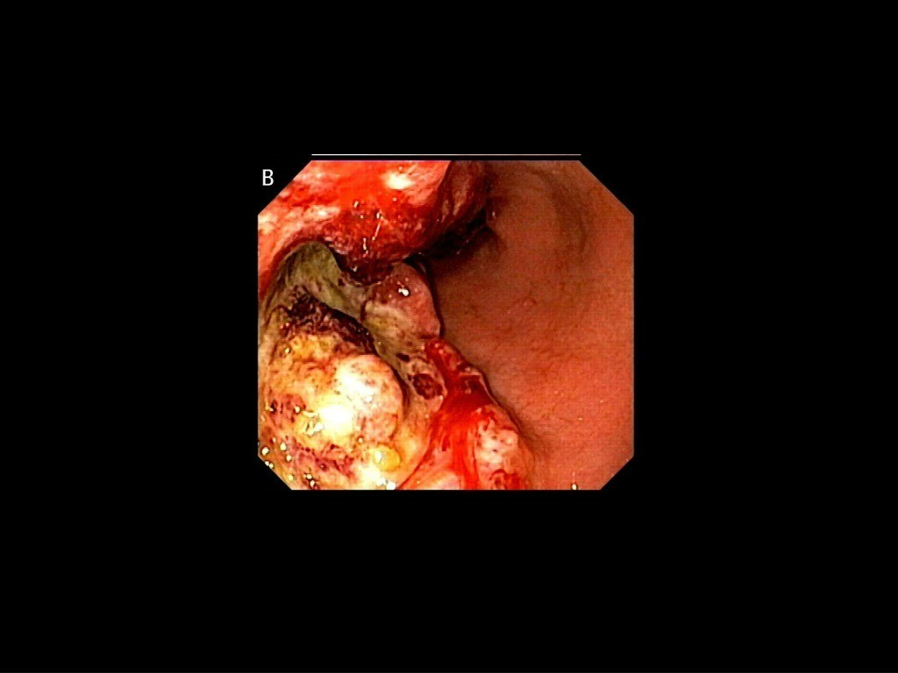

Slide 21
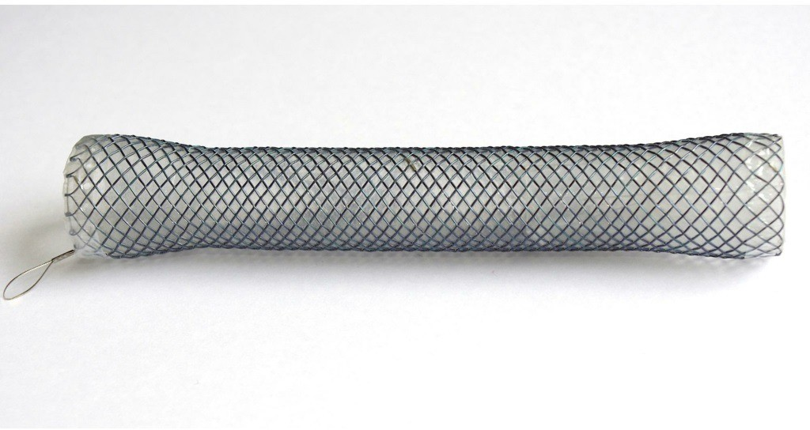

Slide 22
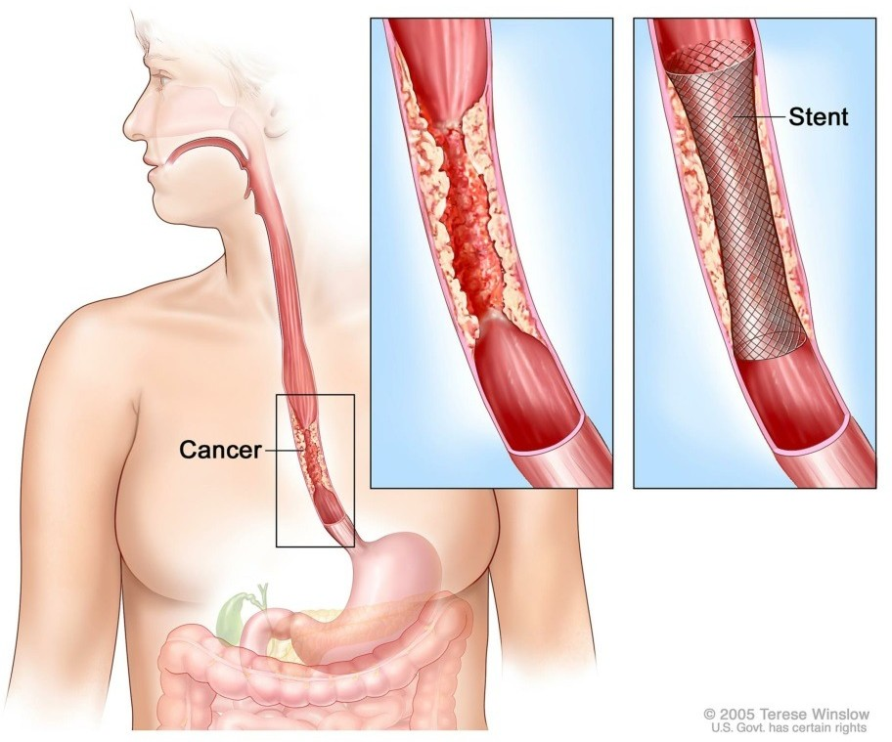

Slide 23
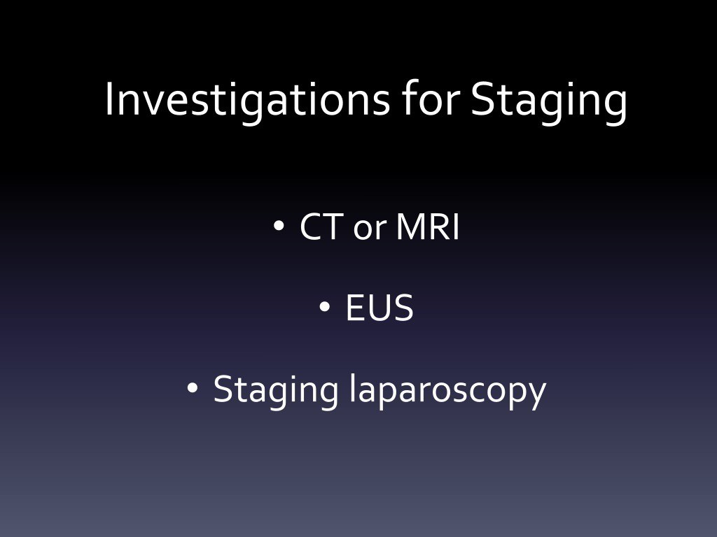

Slide 24
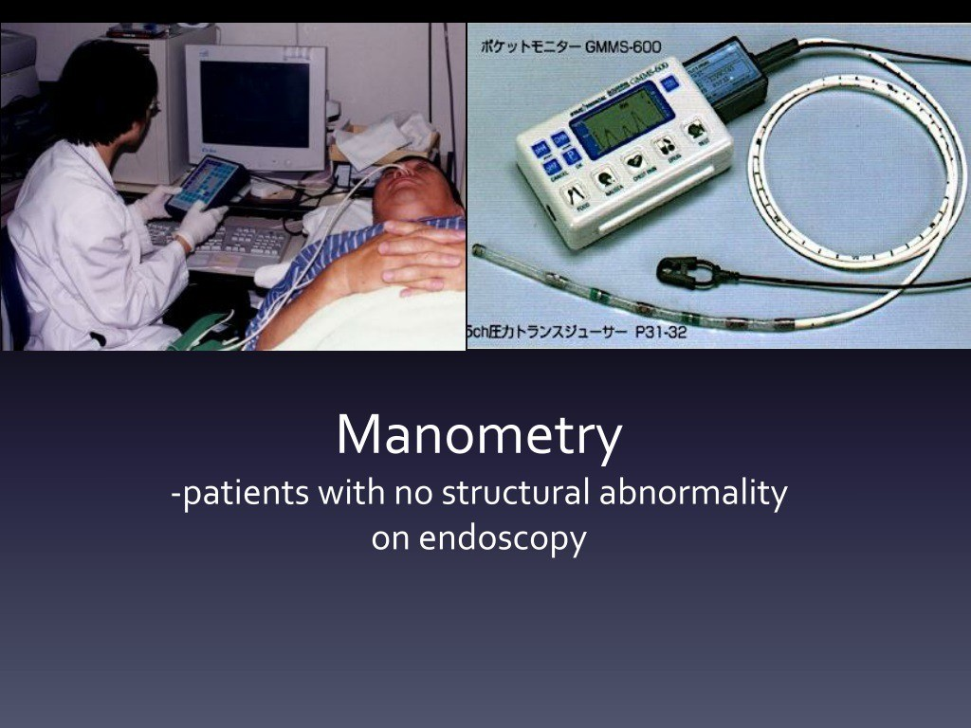

Slide 25
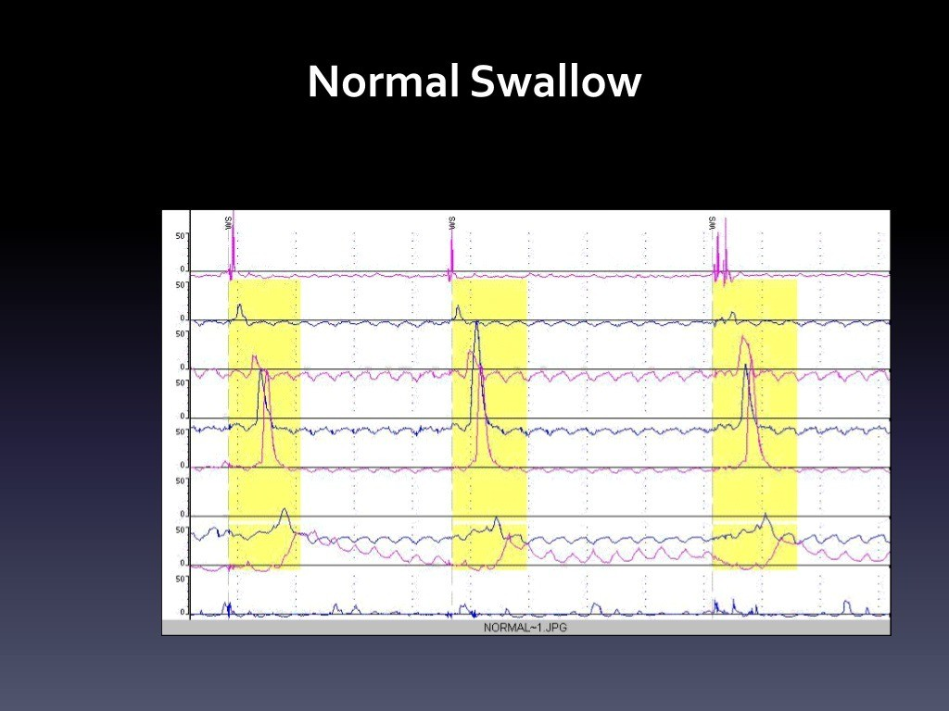

Slide 26
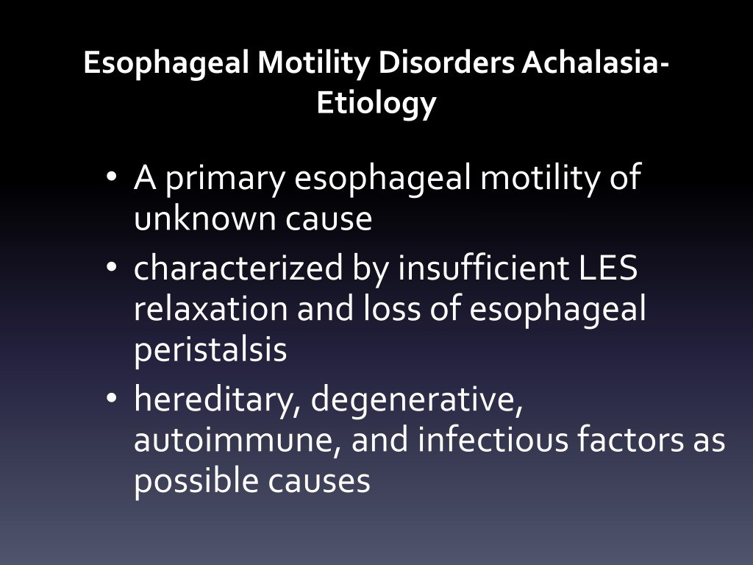

Slide 27
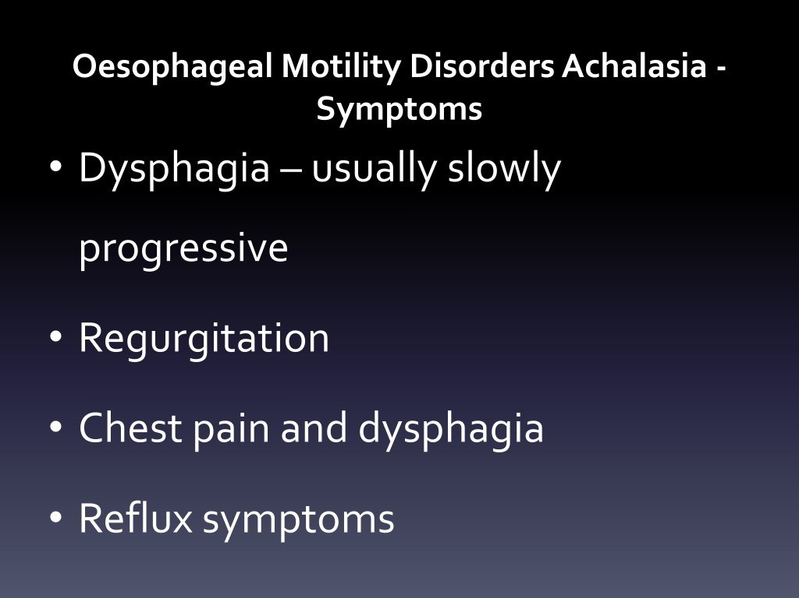

Slide 28
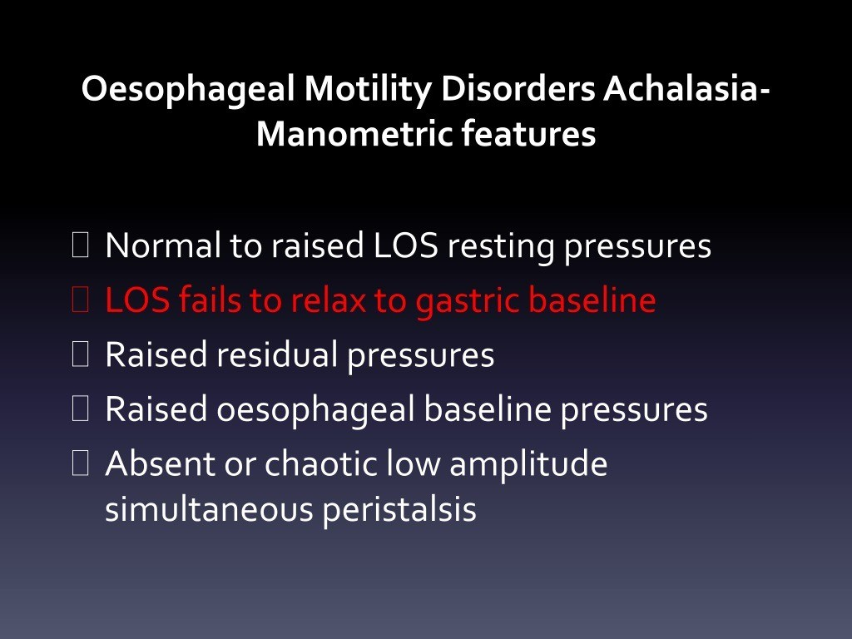

Slide 29


Slide 30
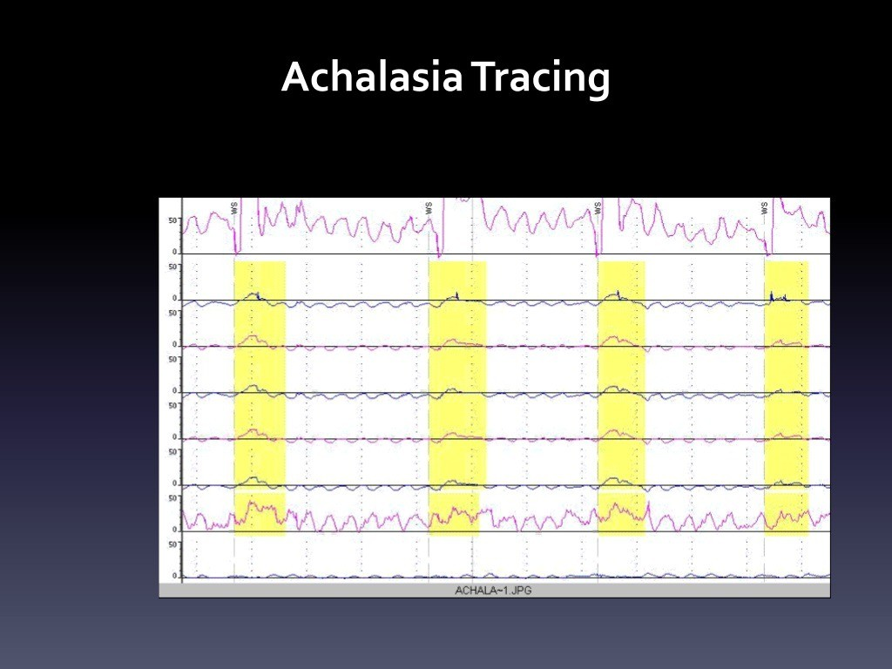

Slide 31
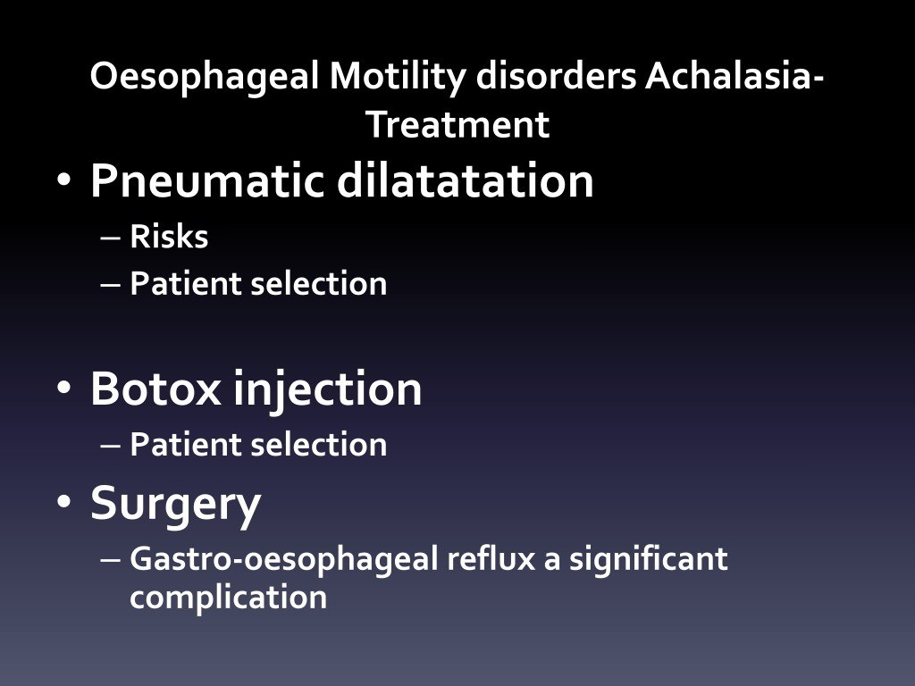

Slide 32
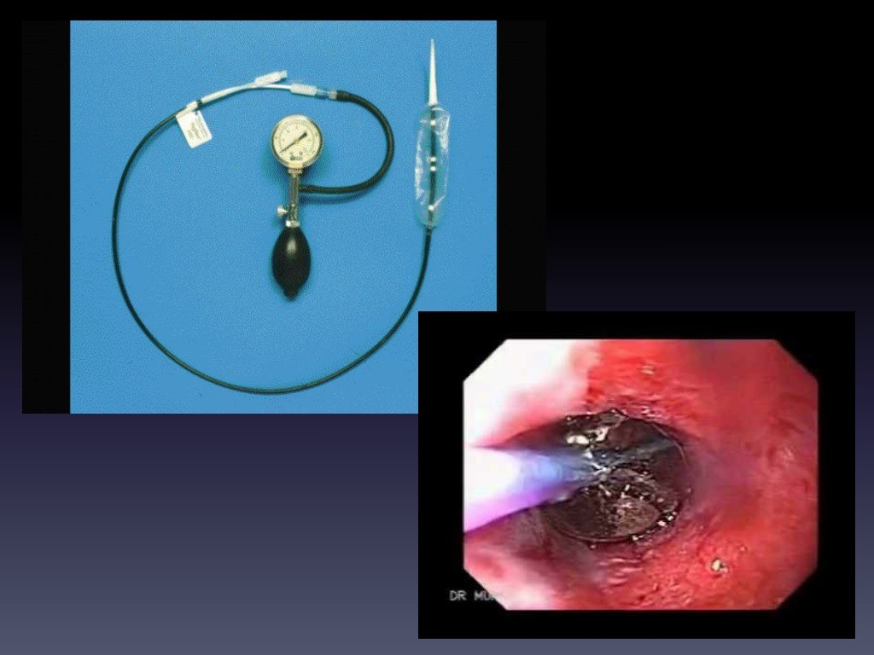

Slide 33
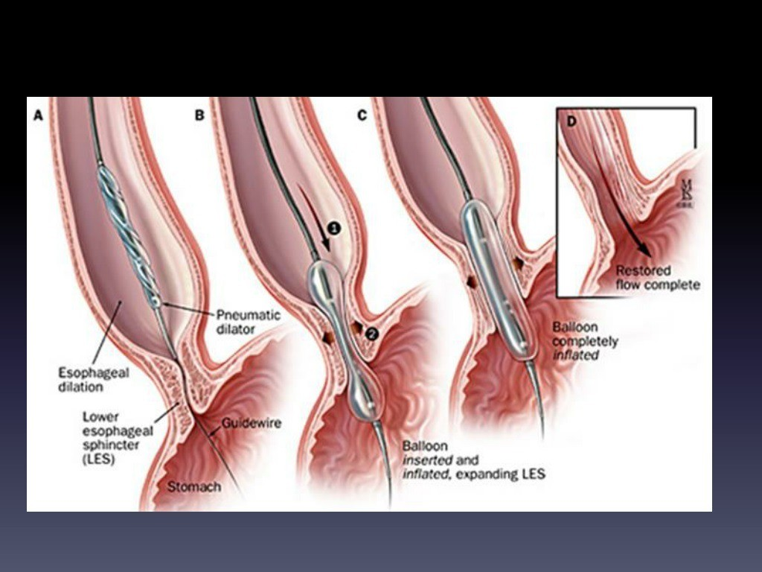

Slide 34
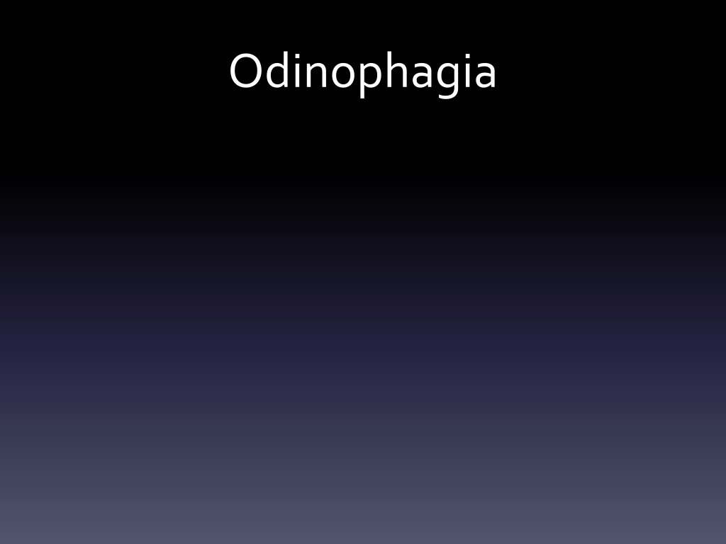

Slide 35
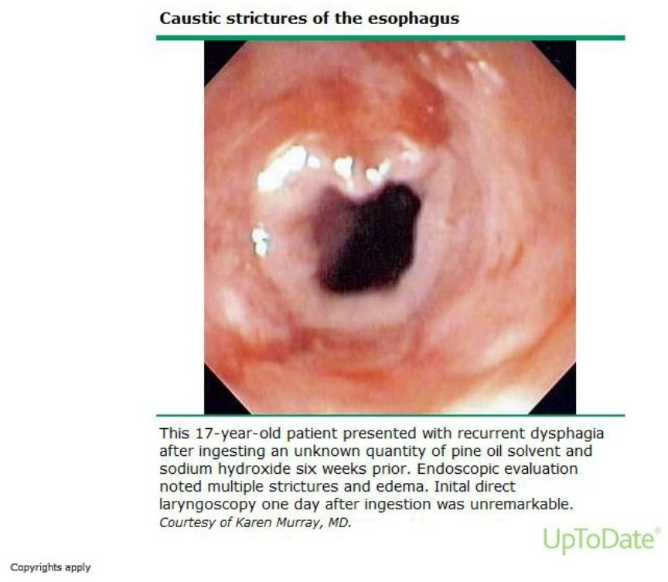

Slide 36
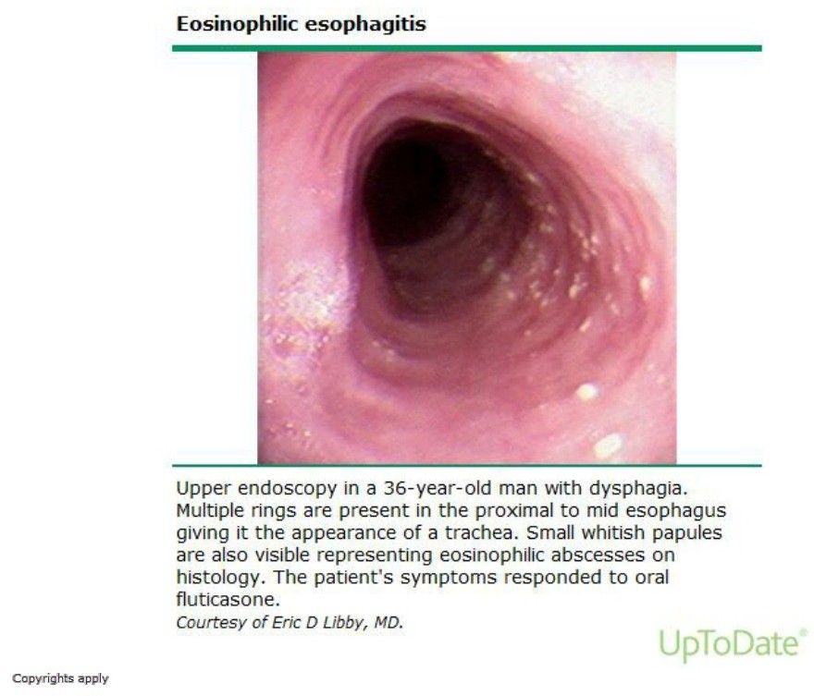

Slide 37
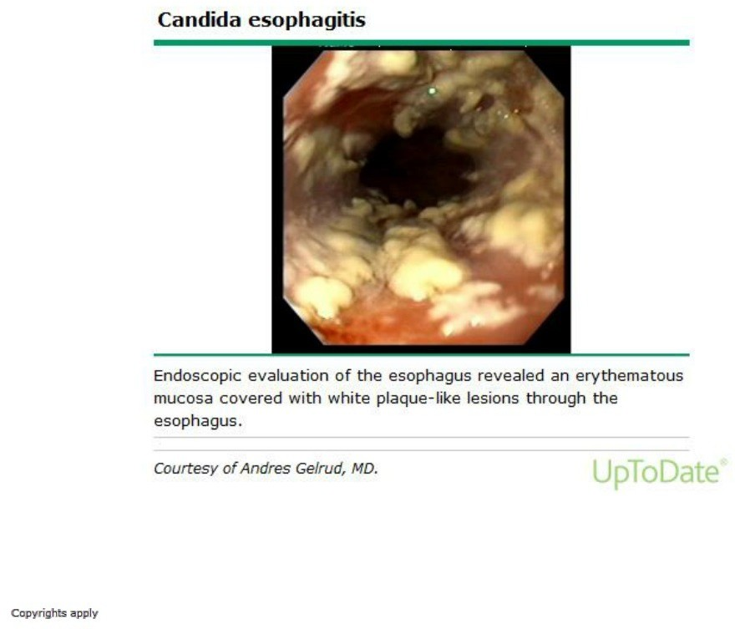

Slide 38
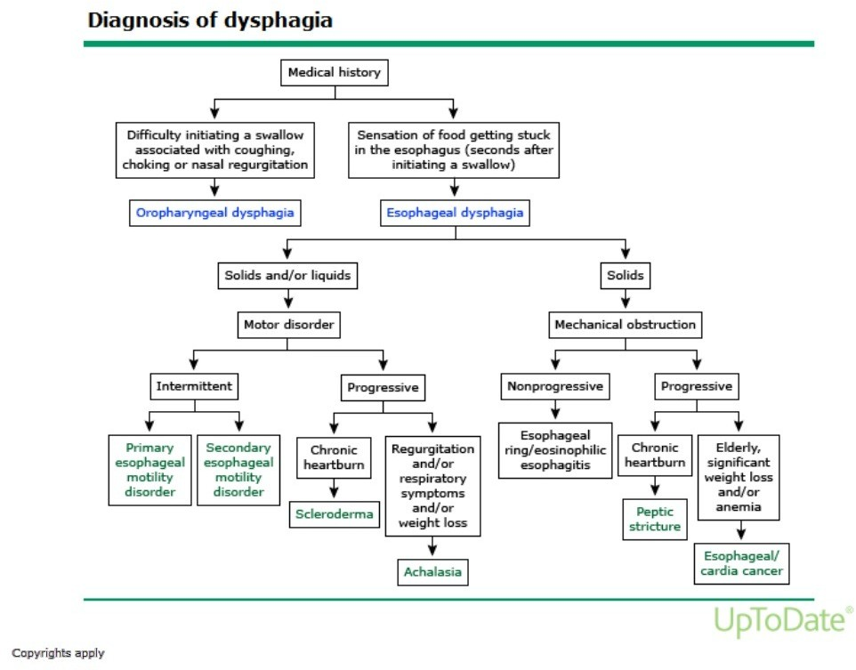

Slide 39
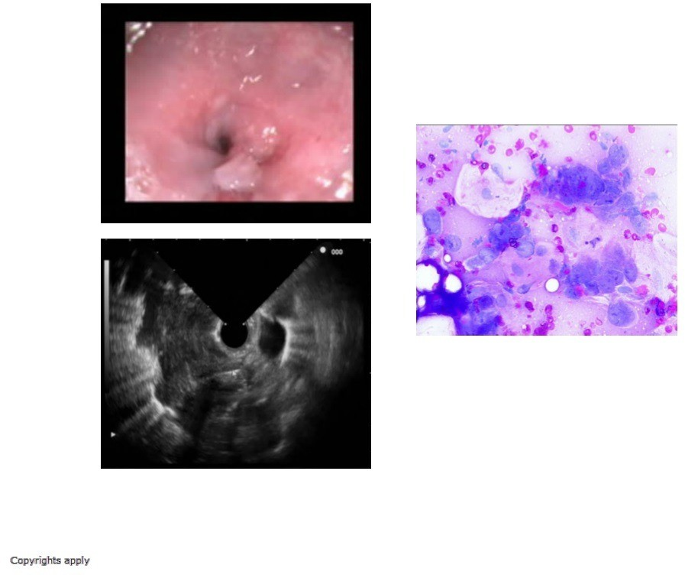

Slide 40
SUMMARY
Dysphagia is defined as difficulty in swallowing. It may coexist
with heartburn or vomiting but should be distinguished from
both globus sensation (in which anxious people feel a lump in
the throat without organic cause) and odynophagia (pain during
swallowing, usually from gastro-oesophageal reflux or candidiasis.
Dysphagia can occur due to problems in the oropharynx or
Oesophagus.
Dysphagia should always be investigated urgently.
Endoscopy is the investigation of choice because it allows biopsy and dilatation of strictures.

Slide 41
REFERENCES
DAVIDSON’S PRINCIPLES AND PRACTICE OF MEDICINE; 23rd edition
HARRISON’S PRINCIPLE OF INTERNAL MEDICINE; 21ST edition
TEXTBOOK OF CLINICAL MEDICINE by S.N Chugh ;5th edition

Slide 42
Any questions?

Slide 43
Thank you

